Slide 1
Abstract Data Types

Slide 2
Abstract Data Types
An abstract data type is a mathematical set of data, along with operations defined on that kind of data
Examples:
  int: it is the set of integers (up to a certain magnitude), with operations +, -, /, *, %
  double: it’s the set of decimal numbers (up to a certain magnitude), with operations +, -, /, *

Slide 3
Abstract Data Types (Contd.)
The previous examples belong to what is called built-in data types
That is, they are provided by the programming language
But new abstract data types can be defined by users, using arrays, enum, structs, classes (if object oriented programming), etc.

Slide 4
Data Structures
A data structure is a user-defined abstract data type
Examples:
  Complex numbers: with operations +, -, /, *, magnitude, angle, etc.
  Stack: with operations push, pop, peek, isempty
  Queue: enqueue, dequeue, isempty …
  Binary Search Tree: insert, delete, search.
  Heap: insert, min, delete-min.

Slide 5
Data Structure Design
Specification
  A set of data
  Specifications for a number of operations to be performed on the data
Design
  A lay-out organization of the data
  Algorithms for the operations
Goals of Design: fast operations

Slide 6
Implementation of a Data Structure
Representation of the data using built-in data types of the programming language (such as int, double, char, strings, arrays, structs, classes, pointers, etc.)
Language implementation (code) of the algorithms for the operations

Slide 7
Object-Oriented Programming (OOP) And Data Structures
When implementing a data structure in non-OOP languages such as C, the data representation and the operations are separate
In OOP languages both the data representation and the operations are aggregated together into what is called objects
The data type of such objects are called classes.
Classes are blue prints, objects are instances.

Slide 8
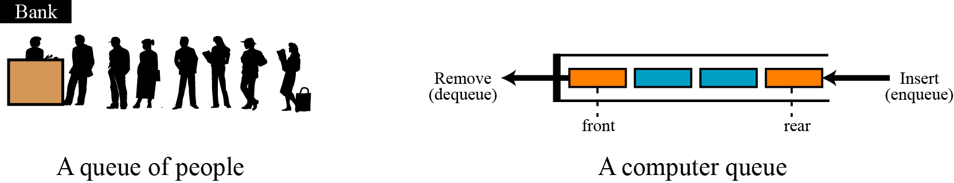
QUEUES
A queue is a linear list in which data can only be inserted at one end, called the rear, and deleted from the other end, called the front. These restrictions ensure that the data is processed through the queue in the order in which it is received. In other words, a queue is a first in, first out (FIFO) structure.
Two representation of queues

Slide 9
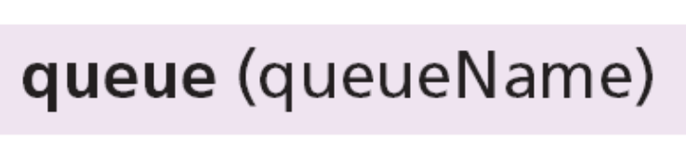
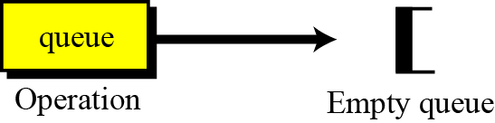
Operations on queues
Although we can define many operations for a queue, four are basic: queue, enqueue, dequeue and empty, as defined below.
The queue operation
The queue operation creates an empty queue. The following shows the format.
The queue operation

Slide 10

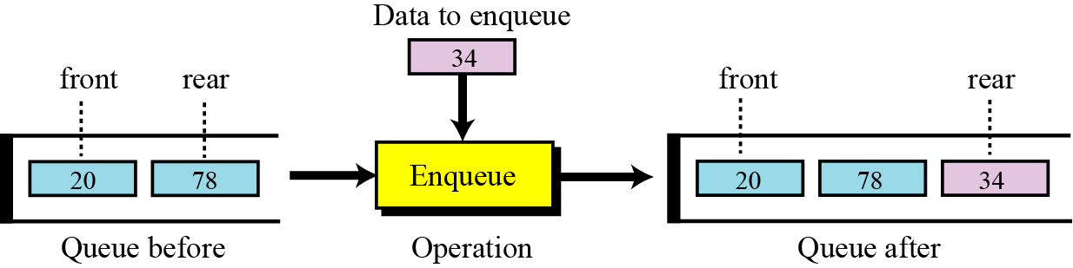
The enqueue operation
The enqueue operation inserts an item at the rear of the queue. The following shows the format.
The enqueue operation

Slide 11
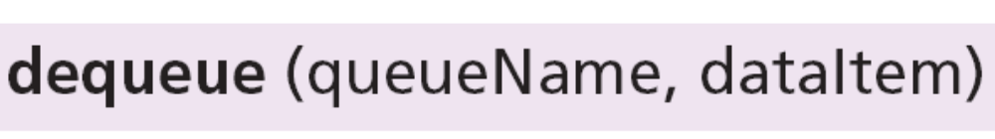
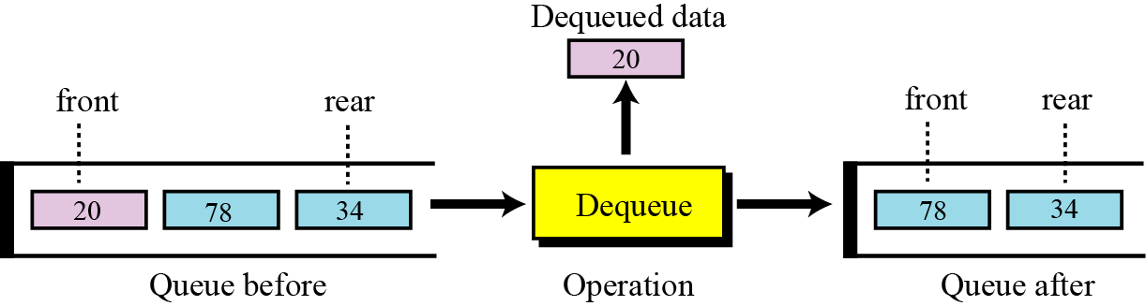
The dequeue operation
The dequeue operation deletes the item at the front of the queue. The following shows the format.
The dequeue operation

Slide 12

The empty operation
The empty operation checks the status of the queue. The following shows the format.
This operation returns true if the queue is empty and false if the queue is not empty.

Slide 13
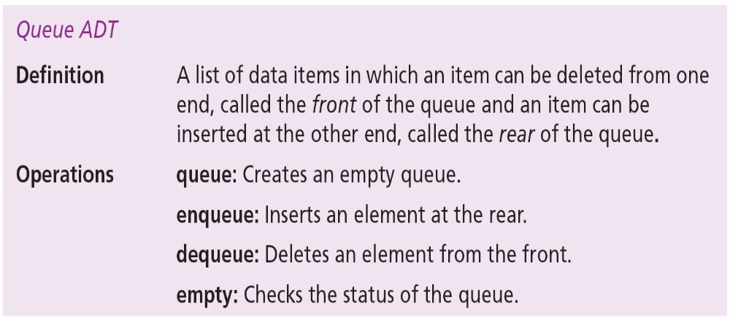
Queue ADT
We define a queue as an ADT as shown below:

Slide 14
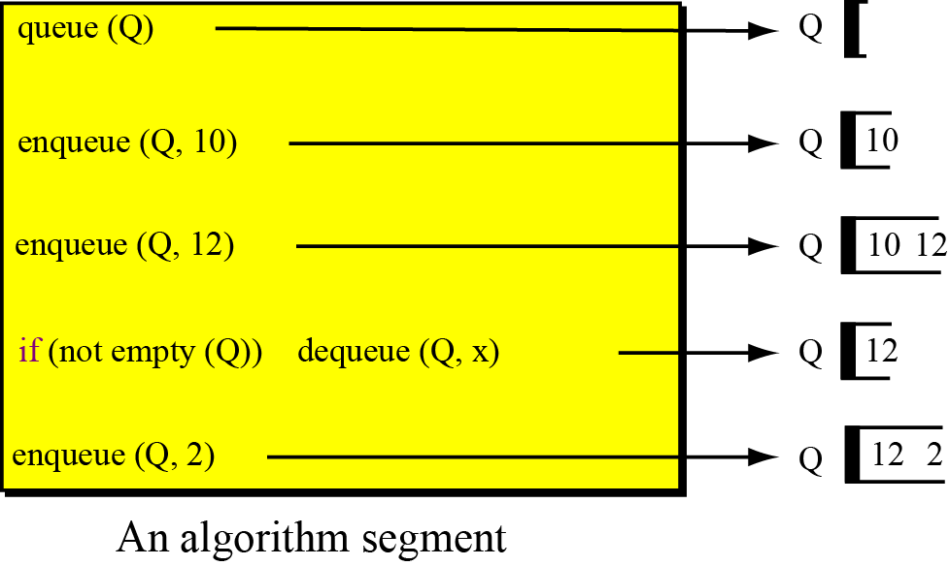
Figure shows a segment of an algorithm that applies the previously defined operations on a queue Q.

Slide 15
Queue applications
Queues are one of the most common of all data processing structures. They are found in virtually every operating system and network and in countless other areas. For example, queues are used in online business applications such as processing customer requests, jobs and orders. In a computer system, a queue is needed to process jobs and for system services such as print spools.

Slide 16
Queue implementation
At the ADT level, we use the queue and its four operations at the implementation level. We need to choose a data structure to implement it. A queue ADT can be implemented using either an array or a linked list.
Example of a queue ADT with five items. The figure also shows how we can implement it. In the array implementation we have a record with three fields. The first field can be used to store information about the queue.
The linked list implementation is similar: we have an extra node that has the name of the queue. This node also has three fields: a count, a pointer that points to the front element and a pointer that points to the rear element.
12.<number>

Slide 17
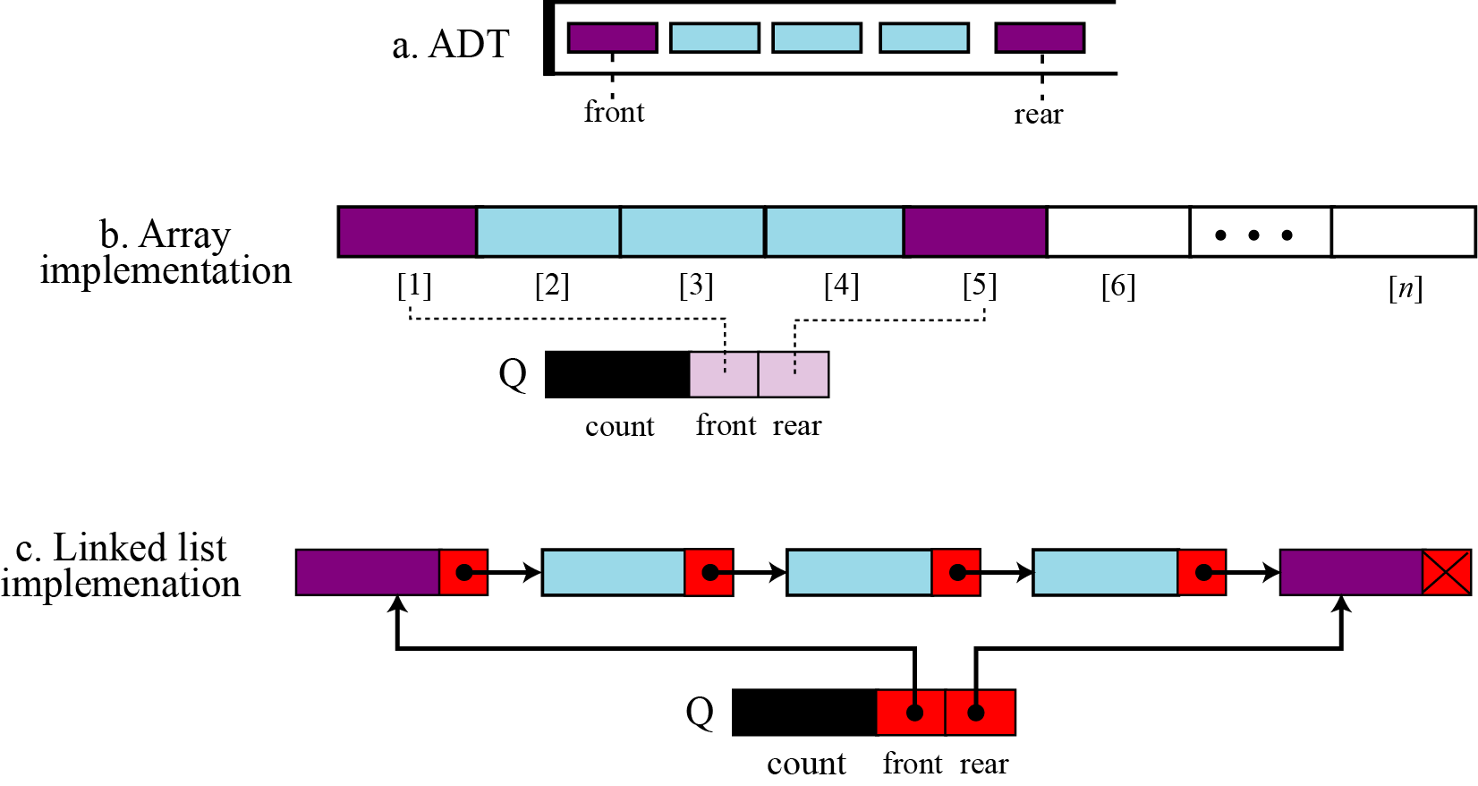
Queue implementation

Slide 18
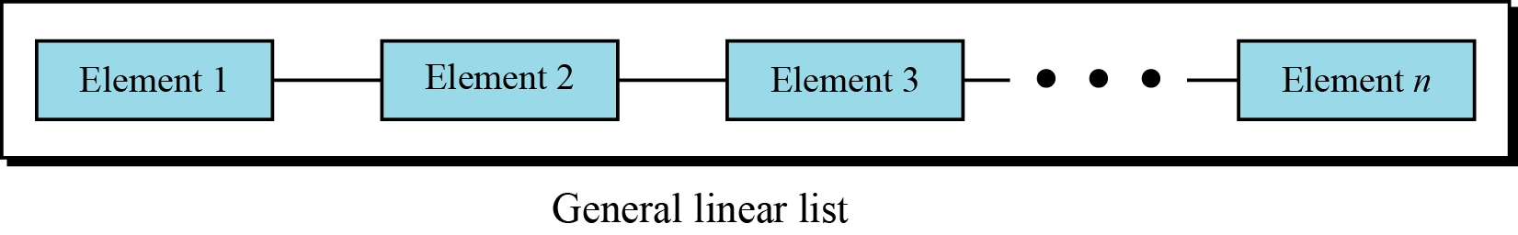
GENERAL LINEAR LISTS
Stacks and queues defined in the two previous sections are restricted linear lists. A general linear list is a list in which operations, such as insertion and deletion, can be done anywhere in the list—at the beginning, in the middle or at the end. Figure shows a general linear list.
General linear list

Slide 19

Operations on general linear lists
Although we can define many operations on a general linear list, we discuss only six common operations in this chapter: list, insert, delete, retrieve, traverse and empty.
The list operation
The list operation creates an empty list. The following shows the format:

Slide 20
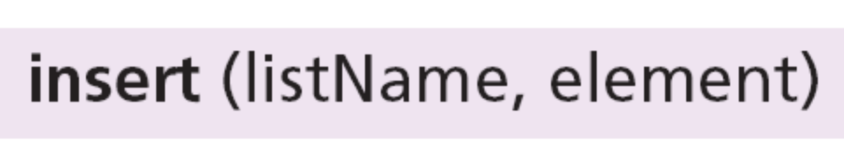
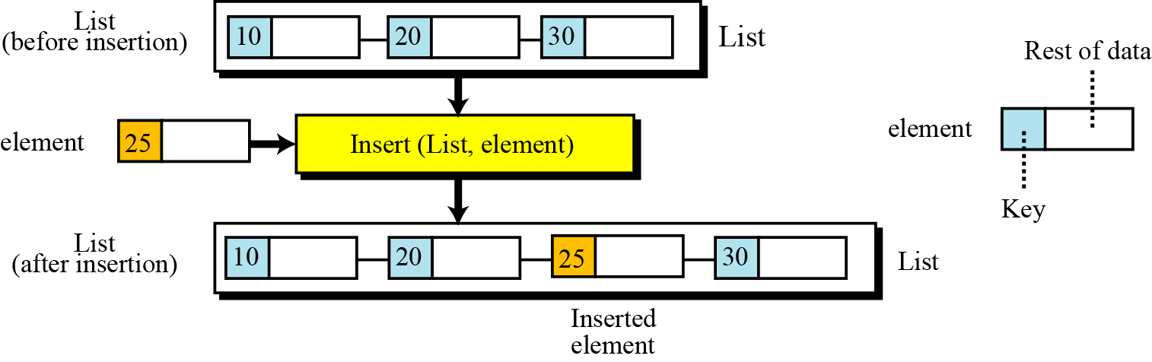
The insert operation
Since we assume that data in a general linear list is sorted, insertion must be done in such a way that the ordering of the elements is maintained. To determine where the element is to be placed, searching is needed. However, searching is done at the implementation level, not at the ADT level.
The insert operation

Slide 21
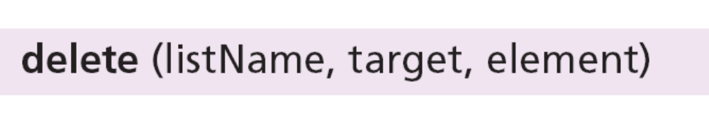
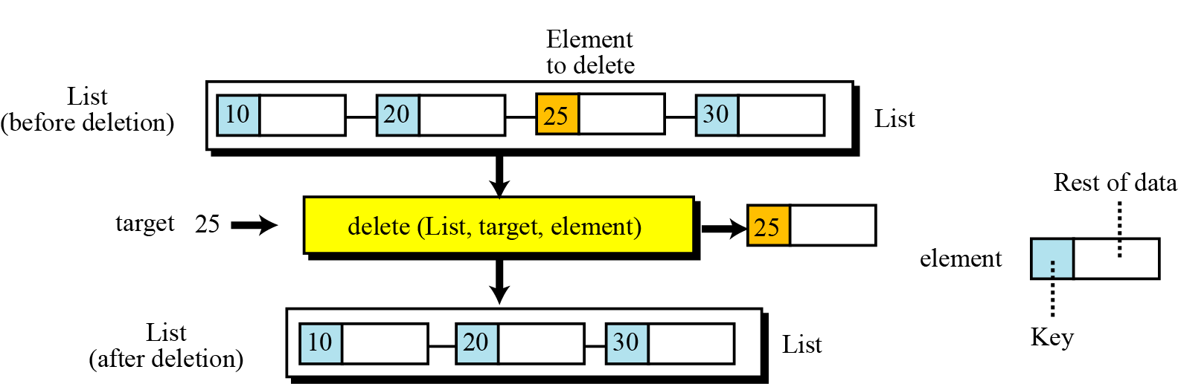
The delete operation
Deletion from a general list (Figure 12.16) also requires that the list be searched to locate the data to be deleted. After the location of the data is found, deletion can be done. The following shows the format:
The dequeue operation

Slide 22
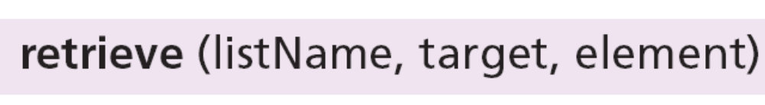
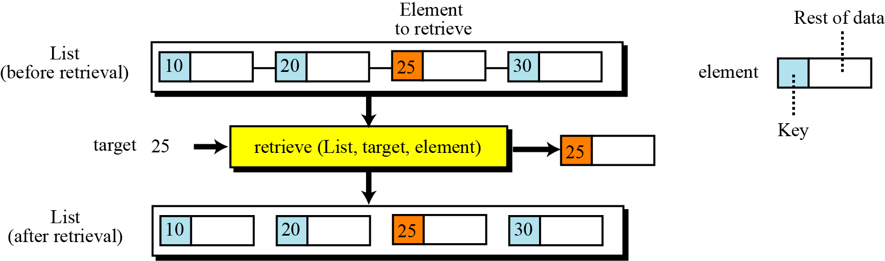
The retrieve operation
By retrieval, we mean access of a single element. Like insertion and deletion, the general list should be first searched, and if the data is found, it can be retrieved. The format of the retrieve operation is:
The retrieve operation

Slide 23


The traverse operation
Each of the previous operations involves a single element in the list, randomly accessing the list. List traversal, on the other hand, involves sequential access. It is an operation in which all elements in the list are processed one by one. The following shows the format:
The empty operation
The empty operation checks the status of the list. The following shows the format:

Slide 24
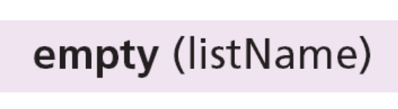
The empty operation
The empty operation checks the status of the list. The following shows the format:
This operation returns true if the list is empty, or false if the list is not empty.

Slide 25
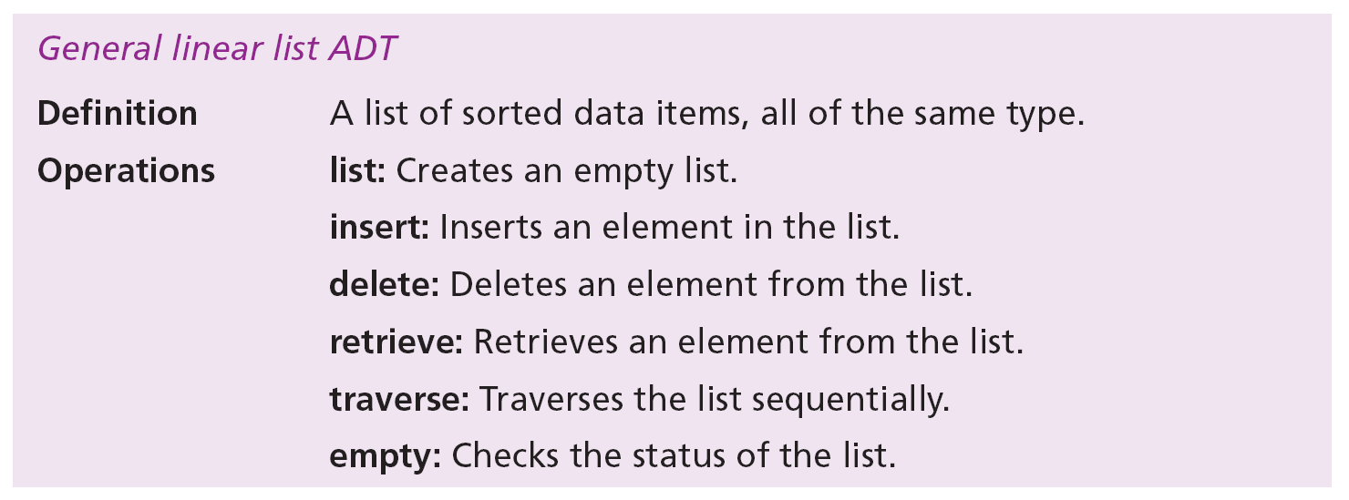
General linear list ADT
We define a general linear list as an ADT as shown below:

Slide 26
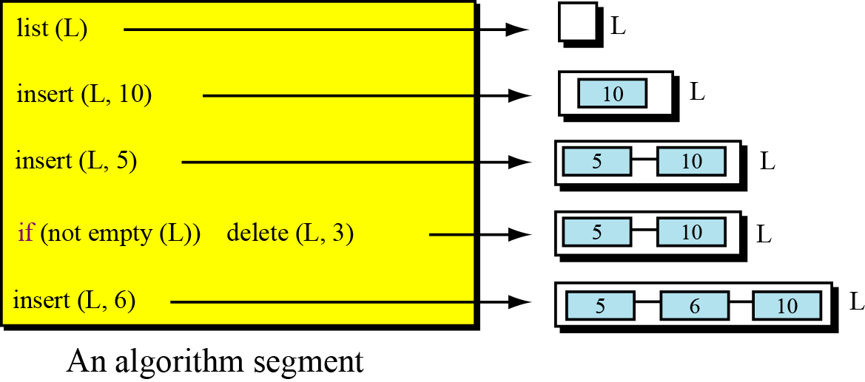
Figure shows a segment of an algorithm that applies the previously defined operations on a list L. Note that the third and fifth operation inserts the new data at the correct position, because the insert operation calls the search algorithm at the implementation level to find where the new data should be inserted. The fourth operation does not delete the item with value 3 because it is not in the list.

Slide 27
General linear list applications
General linear lists are used in situations in which the elements are accessed randomly or sequentially. For example, in a college a linear list can be used to store information about students who are enrolled in each semester.

Slide 28
General linear list implementation
At the ADT level, we use the list and its six operations but at the implementation level we need to choose a data structure to implement it. A general list ADT can be implemented using either an array or a linked list. Figure shows an example of a list ADT with five items. The figure also shows how we can implement it.
The linked list implementation is similar: we have an extra node that has the name of the list. This node also has two fields, a counter and a pointer that points to the first element.

Slide 29
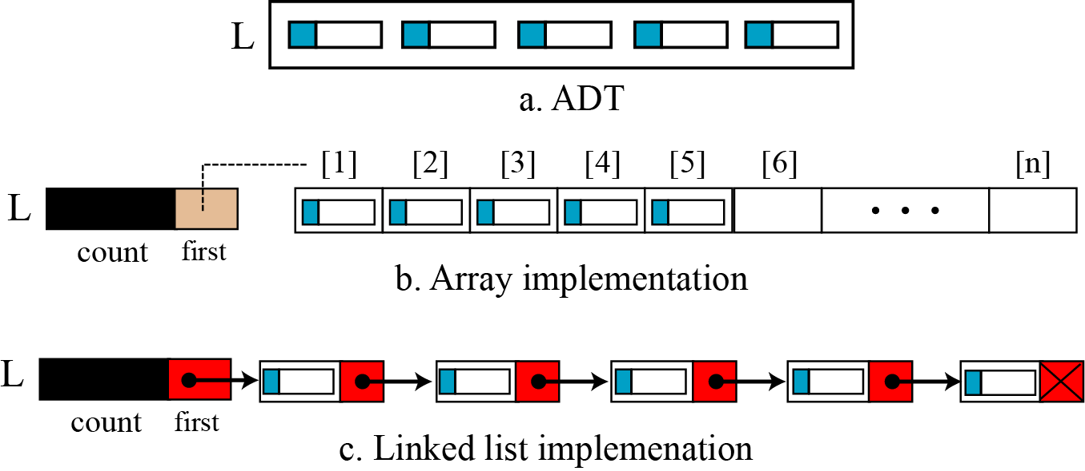
General linear list implementation

